Slide 1
Ridesurance Workflow

Slide 2
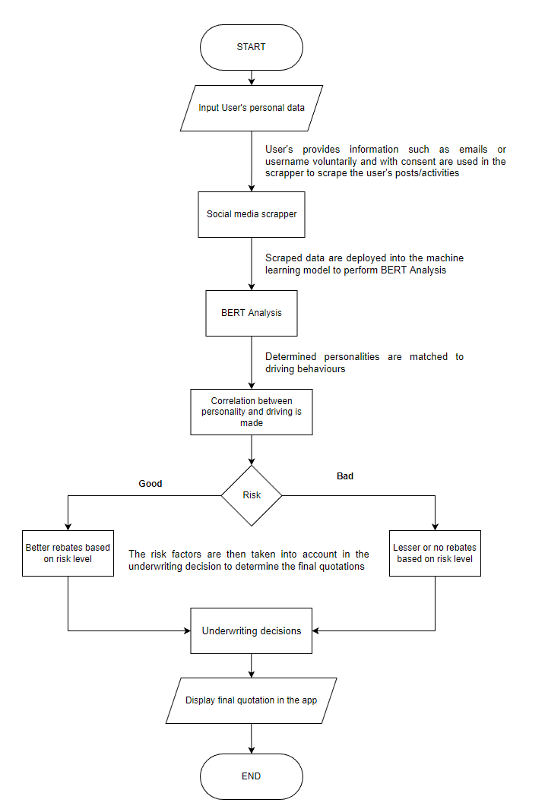

Slide 3
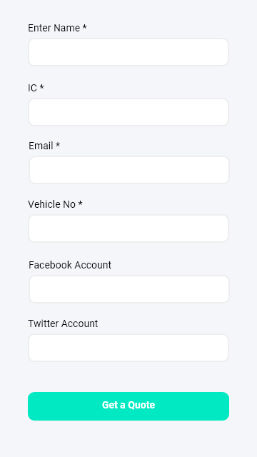
Input user personal data

Slide 4
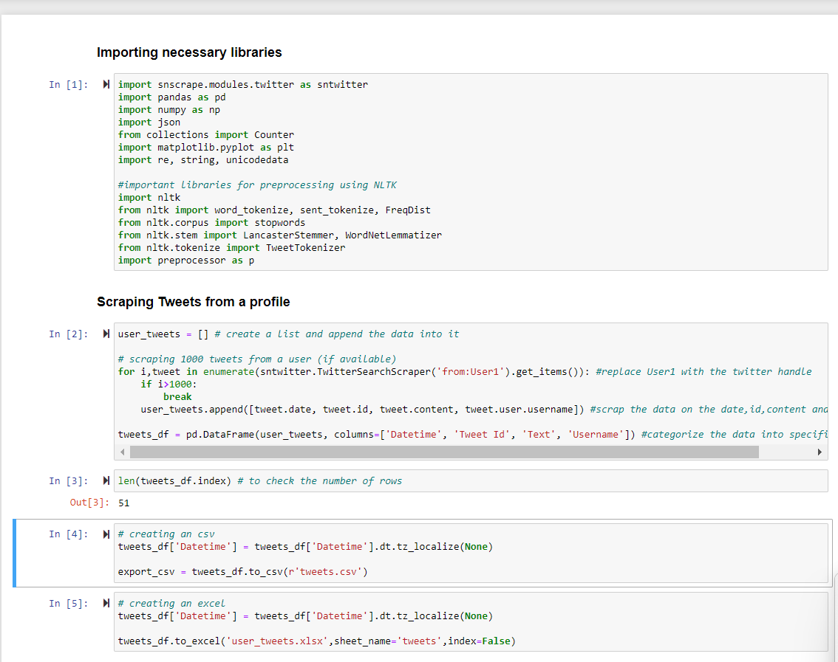
2. Scrap the customers’ social media post, activities, likes

Slide 5
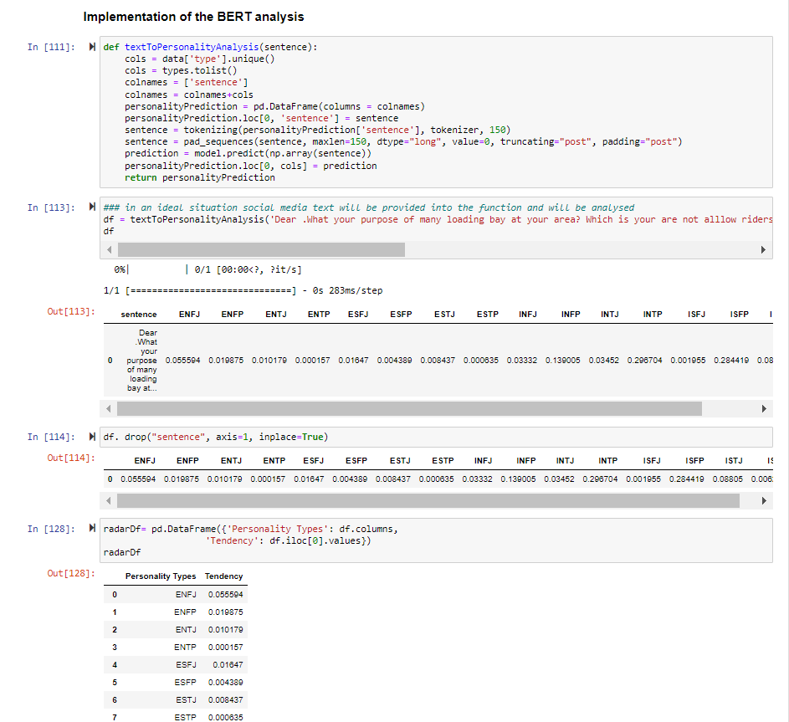
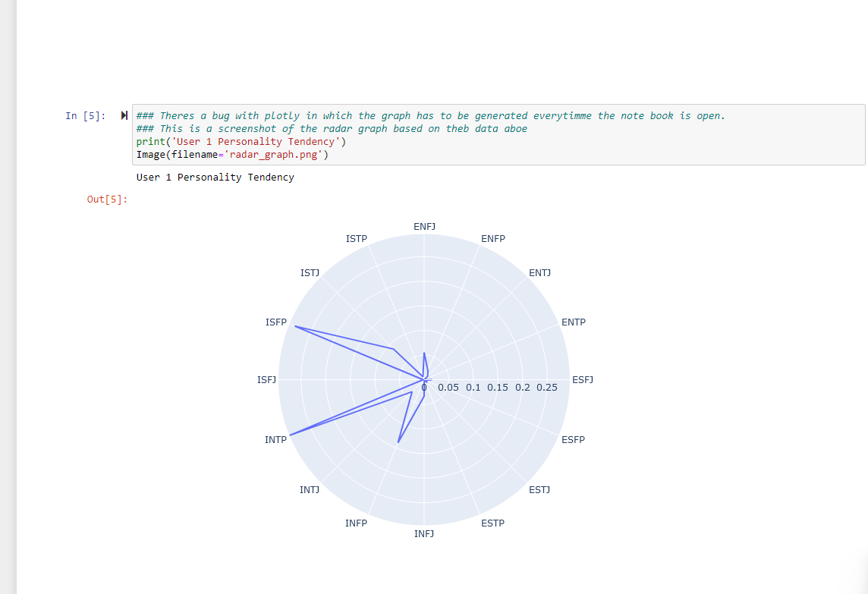
3. Plug social media posts into the model to classify their personality

Slide 6
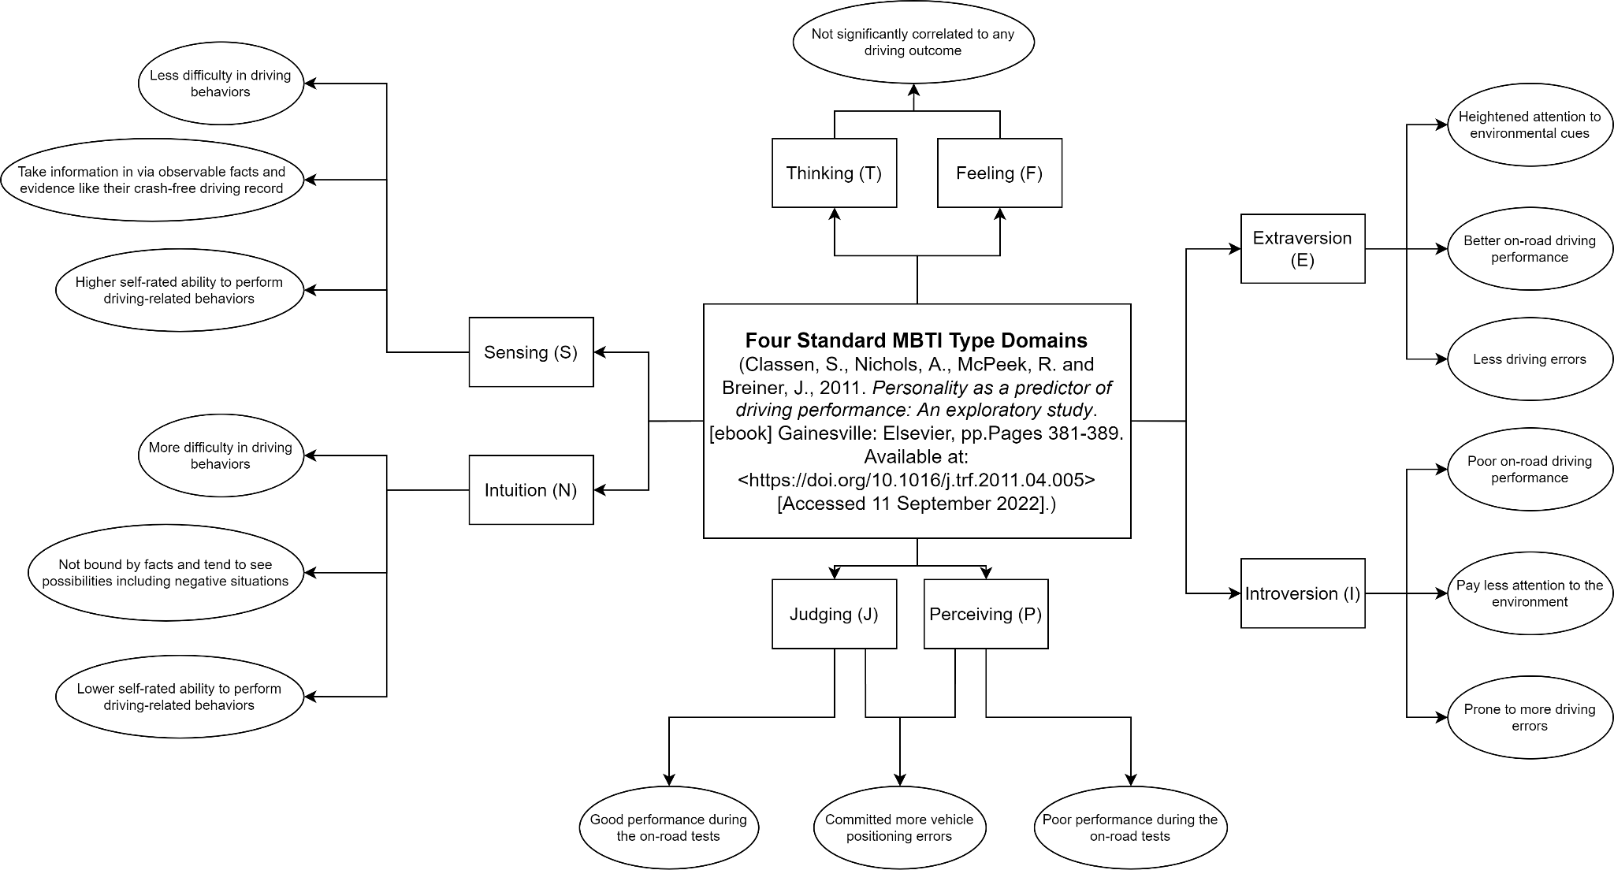
4. Correlate the personality indicator with driving behaviour and determine “good” and “bad risks”

Slide 7
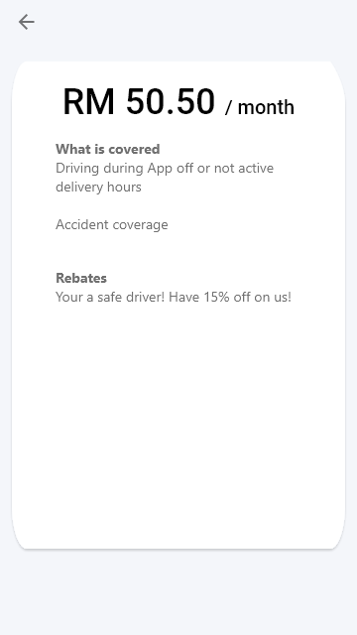
5. Display final quotation for the insurance pricing or premium

